Slide 1
Introduction to communications
Sulochana
CS2032 – Principles of Computer Communication

Slide 2
Lesson Outcomes
After successful completion of this lesson you will be able to:
List down the generic components of a communication network
Illustrate the layered network architecture
Describe the functions of each layer of the OSI model

Slide 3
1. Communication
Sending information from one place to another
Transmission of signals that will be interpreted as data
An information could be transmitted electronically between two points over a physical connection medium
Human voice,
Human visualization
Morse Code
Telegraph
Telephone
1837
1876

Slide 4
1.1 Types of Communication
Video, Text, Voice, Data, Multimedia
Direction of Information Flow
One-way
Interactive – Non real time
Interactive – Real time
Number of parties involved
Two-party
Multi-party

Slide 5
2. Network
A system that connects devices for communication:
PSTN: Public Switched Telephone Network
LAN: Local Area Networks
Television Network
Vehicular Networks
Internet

Slide 6





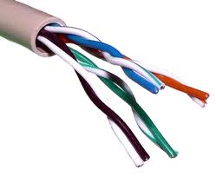
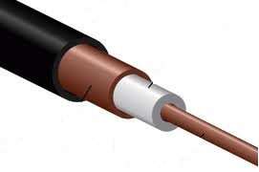

2.1 Components of a Network
Terminals for Access
Equipment for Switching
Media for Transmission

Slide 7
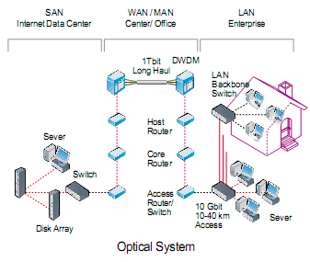
2.2 How to study a Network

Slide 8
2.3 Challenge
Different architecture
Different languages
Different data formats
Different communication rates
Modularization
Layering
Standardization

Slide 9
3. Layered Architecture
Separate functions
Transparent Implementation
Flexible to modify
Independent design and testing
E.g: OSI Reference Model, TCP/IP Model

Slide 10
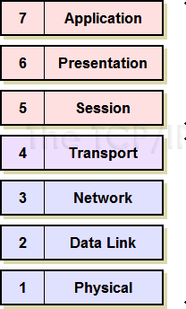
4. OSI Model
Open System Interconnect (OSI)
Communication regardless of underlying architecture
7 Layers
Layer – well defined function
Boundaries – minimum information flow across

Slide 11
4.1 Physical Layer
Purpose
Accept a raw string of bits and deliver it across a link
Functions
Encoding and signaling
Data transmission and reception
Topology and physical network design
Hardware Specifications – operations of cables, connectors, wireless radio transceivers, network interface cards and other hardware devices

Slide 12
4.2 Data Link Layer
Purpose
Provide error free transmission across a single link
Functions
Data framing
Error Detection and handling
Flow Control
Addressing – hardware level

Slide 13
4.3 Network Layer…cntd
Purpose
Deliver packets (datagrams) from sender to the receiver (host-to-host) across a communications network
Shield higher layers from the details of how packets got to their destination

Slide 14
4.3 Network Layer
Functions
Logical Addressing
Which machine to send the packet to
Routing
How to get there
Datagram encapsulation
Congestion Control
Lot of packets in the network core
Quality of Service
Guarantee levels of service

Slide 15
4.4 Transport Layer
Purpose
Provide end-to-end delivery from one host to the other
Functions
Connection establishment, management and termination
Multiplexing and demultiplexing
Error detection and correction
Flow Control
Quality of Service

Slide 16
4.5 Session Layer
Purpose
Provide a means of controlling the dialog between two end-users (applications)‏
Functions
Dialog Control (full vs half duplex)‏
Token Management
Synchronisation
Recovery Management
Not often implemented in real systems

Slide 17
4.6 Presentation Layer
Purpose
Formatting data for transmission
Functions
Translation
Compression
Encryption
In practice not implemented in a separate layer but included elsewhere – e.g. in the applications

Slide 18
4.7 Application Layer
Purpose
Provide network based applications to users
File transfer, Electronic Mail, World Wide Web, Virtual Terminal, Instant Messaging, Directory Services, Remote file systems
Some widely used applications are standardized

Slide 19
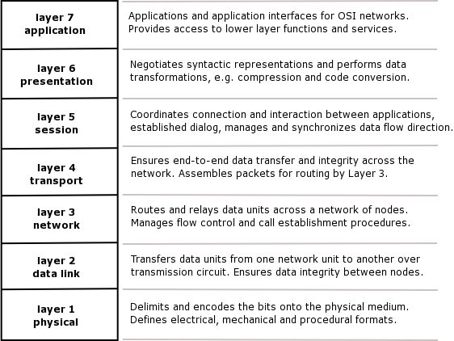
4.8 A Quick Recap
Credit to : http://ccna-cisco.webs.com/osiiiii.png

Slide 20
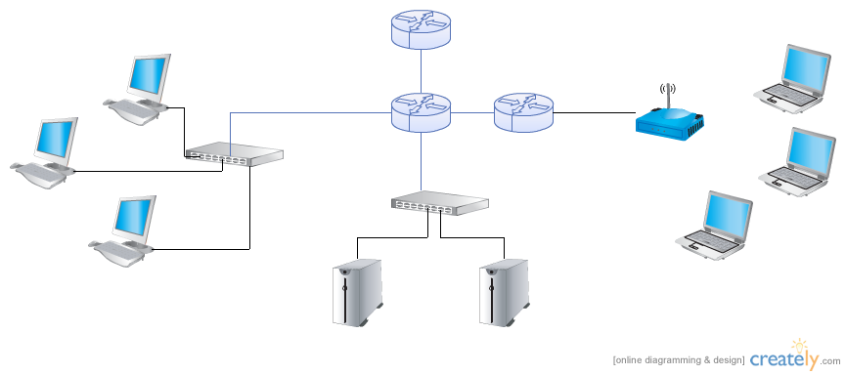
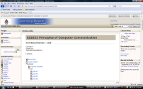
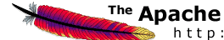
4.9 OSI Layers in Operation

Slide 21
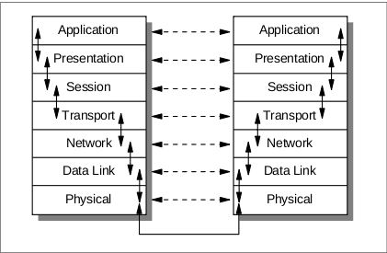
4.10 Communication in OSI Model
http://www.supportsages.com/blog/wp-content/uploads/2010/09/Osi_layer.png

Slide 22
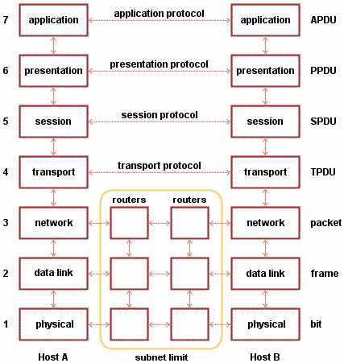
5. CS 2032 - Scope
Physical Layer in depth
Touches DLL
Introduce briefly Network layer and Application layer

Slide 23
5.1 CS2032
Principles of Computer Communications
Data Communications
Course Outline
Mode of Delivery
Lectures
Tutorials
Labs
Assessment
CA % Exam %

Slide 24
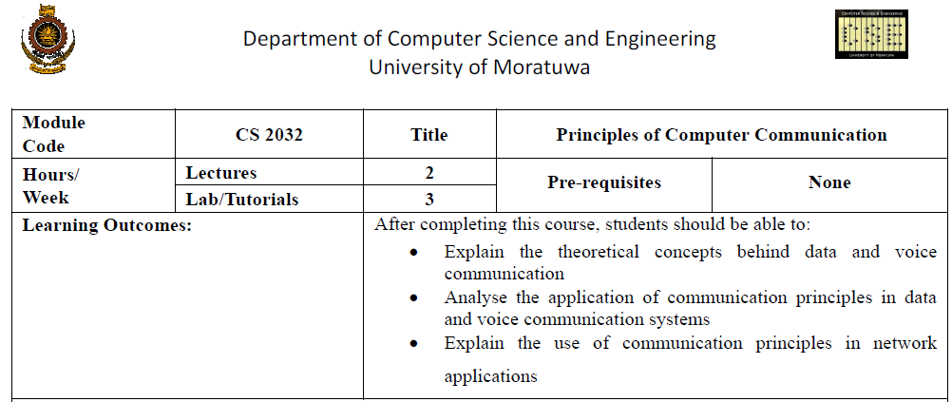
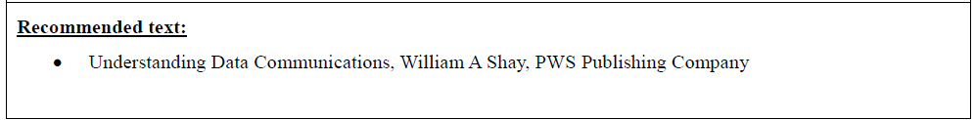
5.2 Course Outline

Slide 25
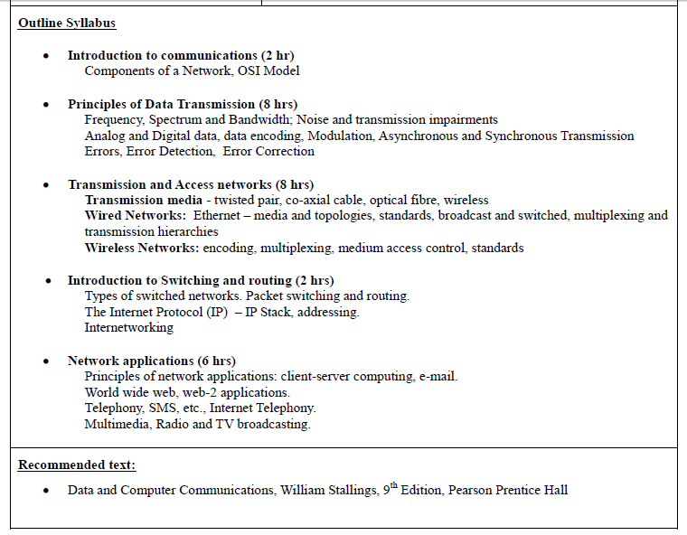

Slide 26
6. Revision
List down the generic components of a communication network.
What are the layers in OSI model?
Write down a functionality per each layer.

Slide 27
Thank you

